Slide 1
The Changing CI Proposition
Peter Banthorpe, Head of Actuarial Research, RGA UK
Yunus Piperdy, R&D Underwriting Manager, RGA UK

Slide 2
Table of Contents
Evolution of CI in the UK
Pricing New CI Conditions
Developing New CI Conditions
Underwriting and Claims considerations

Slide 3
Evolution of CI in the UK

Slide 4
CI Sales Volumes in the UK
First ABI SOBP
Policy Prices Failing
Property Prices Rising
1.5bn in Commission paid on Term and CI
Fall in endowment sales
Move to repayment mortgages
Source: Various market data, blended by RGA analysis

Slide 5
CI Sales Volumes in the UK
First ABI SOBP
Policy Prices Failing
Property Prices Rising
1.5bn in Commission paid on Term and CI
Fall in endowment sales
Move to repayment mortgages
2003 / 2004: 50% increases in CI premiums following the withdrawal of a major reinsurer from the Guaranteed rate market at the end of 2002.

Slide 6
Evolution of Critical Illness
Conventional CI products have always dominated market place
First CI Launches
First ABI SoBP
1985
1991
2002
1987
1999
2006
2007
2008
2012
Notes:
Original product launch 7 illnesses, pricing was a stab in the dark but had reviewable premiums.
Elixia: Life threatening (Big 3 in here) , Disabling, Traumatic - eventually dropped last year.

Slide 7
Current Product Variants
We have both ends of the extreme at present.....
Complexity
Simplicity
Serious Illness Plan
Trauma Choices
Pros
Cons
Pros
Cons
Wide Cover
Benefits closer match to need
Very complex!
Relatively Expensive
Quick to underwrite (86% POS, average 7 mins)
Simple
Less UW means higher price
Less Cover
Notes:
161 Conditions
6 tiers of payout (from 10% to 100%)
Advised distriubution with full underwriting
5 Conditions
Average new business process = 7 mins

Slide 8
Mainstream Critical Illness Product
Moving to complexity
Complexity
Simplicity
More Definitions
Partial Payments
ABI+
Notes:
Source: L&G Policy History (Counting HIV only ever as 1 definition) http://www.legalandgeneral.com/library/protection/adviser-guide/W13466.pdf

Slide 9
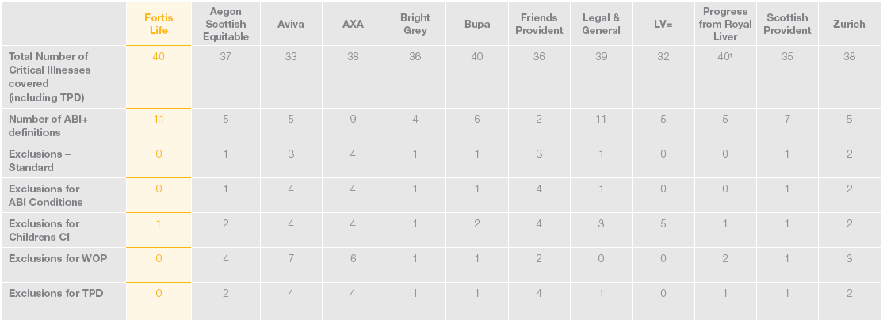
The move to complexity
IFA Critical Illness Products – November 2010
Source: Fortis Life Critical Illness Guide, as at 17 November 2010
http://www.fortislife.co.uk/static_site/assets/downloads/lowres/sales-aids/CI_Combined_Sales_Aid.pdf

Slide 10
The move to complexity
IFA Critical Illness Products – 18 Months later
Source: Ageas Protect Critical Illness Guide, accessed 20 May 2012
http://www.ageasprotect.co.uk/Document/1198_CriticalIllness_ComparisonGuide.pdf
Change in: | Ageas | Aviva | Bright Grey | Friends Life* | Legal and General | LV= | Scottish Provident | Zurich
Full payment Definitions | 0 | 1 | 5 | 5 | 0 | 9 | 6 | 0
Partial payment Definitions | 0 | 2 | 2 | 2 | 0 | 7 | 2 | 0
ABI + Definitions | 4 | 7 | 5 | 8 | 0 | 11 | 2 | 2
* Friend Life compared to BUPA
Notes:
12 companies have become 8:
3->1 , Friends Life
No Progress
No Aegon -> I wonder why ..... 40 full (including TI and TPD) , 1 partial (Mastectomy)
Children’s CI not in these numbers.
Note: new Row added – definitions resulting in partial payments.....
Note this is moving towards a severity based product but will be ever get a main stream severity based product?

Slide 11
Drivers of Change in CI Product Design
Competition on Quality and price
ABI Statements of Best Practice;
Comparison services e.g. Defaqto, CI Expert;
New Entrants;
Published Claims Statistics => Visibility of declinature rates
Objective definitions;
Definitions which do what they seem to say;
Non-disclosure;
Notes:
So what is driving this change in the market
Most companies would probably say they don’t want to keep on adding more and more conditions but they feel compelled to by the comparison services – but is it in the customers best interests – ever more complex.
Helped consumer confidence and advisor confidence – and helped to restore trust in the market. Certainly not getting watchdog stories every few months. Came at a hard time for the market through the recession.
Published claim statistics, 2004 lifesearch started calling for this. 2006 80.8% in 2009 it was 90.6%

Slide 12
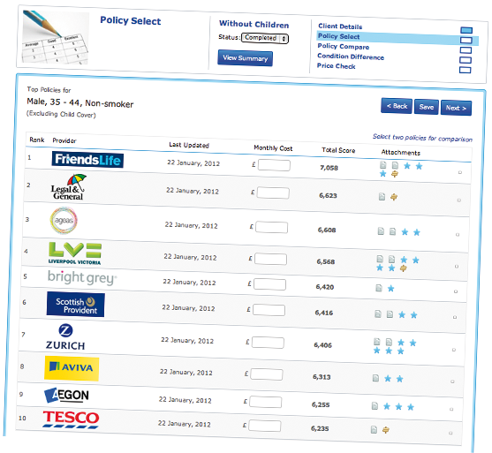
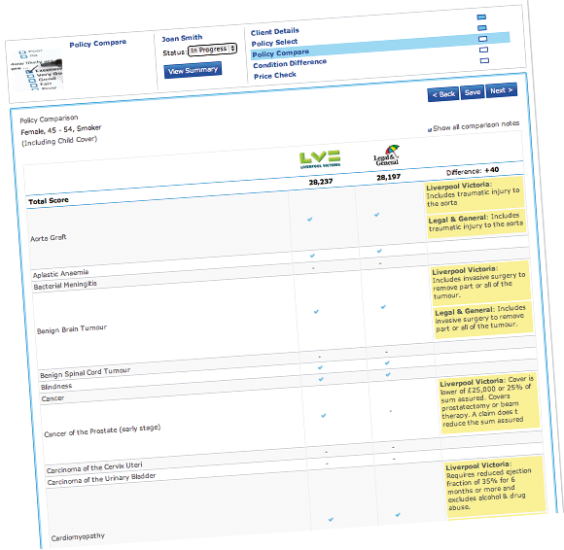
Comparison Services
Example Output from

Slide 13
Published Claim Statistics

Slide 14
CI Conditions
Pricing
New

Slide 15
History of UK CI Pricing
Current Level of Experience
1985
Pricing Based on Population Studies
Dash and Grimshaw (1995)
Early 21st Century
Mixture of Population and Insured Experience
A Critical Review (2000) / Exploring the Critical Path (2006)
2010
Largely Insured Experience Pricing based on:
Own data;
CMI data;

Slide 16
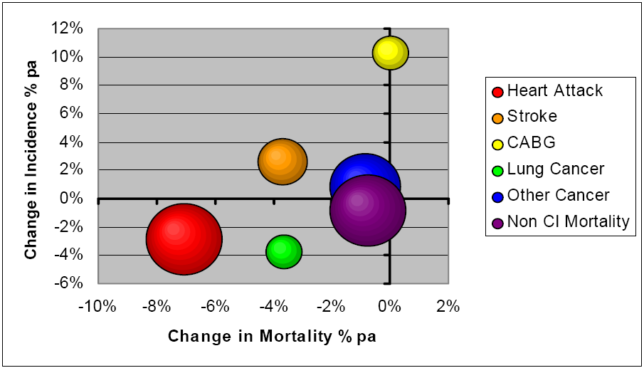
Pricing Trends
Recent past best guide to short-term future
Best Estimate Avg Change % pa, England & Wales, 1980-2000
Men, aged 40 - 60
Size of Balls Indicates Relative Importance of CI Measured by Incidence Rate.
Source: Presentation to the 2004 Healthcare Conference by the CI trends Working Party

Slide 17
Pricing Trends
But longer term rely on research of future medical advances
Consultation with Expert CMO panel;
Strictly moderated sessions for each of the 16 conditions considered;
Production of expert “Expert Opinion Statement” which summarises consensus on:
Level and direction of recent Population past trends
Rationale for recent past trends
Projected trend for next 10 years and subsequent 10 years, with accompanying rationale
Potential ‘shocks’ in next 10 years and subsequent 10 years, with accompanying rationale
Notes:
Don’t forget about lapse rates too.

Slide 18
Pricing New Minor Conditions
Rates
Obtain population incidence rates
Possible sources: Medical Papers, National Databases
Errors
Understand the data and correct for any known errors
Severity
Insured Definition probably won’t match medical definition;
Adjust for differences.
Insured
Overlaps
Population sources often include either double counting or under reporting
Adjust for differences between Population and insured experience
In particular, socio-economic bias and impact of underwriting
Reduce costs if elements of the definition already covered elsewhere
Notes:
The steps involved in pricing a new conditions from scratch.

Slide 19
Example : Ductal Carcinoma In Situ Requiring Mastectomy
Why?
Popular additional cancer related CI condition
Around 10 Insurers cover it as a partial benefit
Definitions vary from full mastectomy through to partial mastectomy
Has existed in the market for a number of years so pricing approach isn’t that sensitive anymore!
Indeed, priced before the highly useful National Mastectomy and Breast Reconstruction Audits published.
Pricing the original form of the benefit – Pip will talk through variations later....
Notes:
Ten insurers include Mastectomy cover within their plans. They will only pay out if the entire breast is removed.
Ageas pays the lower of 50% of the sum assured of £25,000 whereas PruProtect will pay 25% of the sum assured with no monetary limit. L&G provides the lower of £25,000 and 25% of the sum assured whereas Aegon and Aviva offer the lower of £20,000 or 20% of the sum assured. Bright Grey and Friends Life pay out the lower of £12,500 or 12.5% like LV.
Aviva, Bright Grey, Friends Life, LV and Scottish Provident extend their cover to include partial mastectomy, segmentectomy and lumpectomy which provides far greater potential for a claim. PruProtect also provides a 10% payment for lumpectomy, cystectomy or partial mastectomy. L&G provides the lower of £25,000 and 25% of the sum assured whereas Aegon and Aviva offer the lower of £20,000 or 20% of the sum assured. Bright Grey and Friends Life pay out the lower of £12,500 or 12.5% like LV.

Slide 20
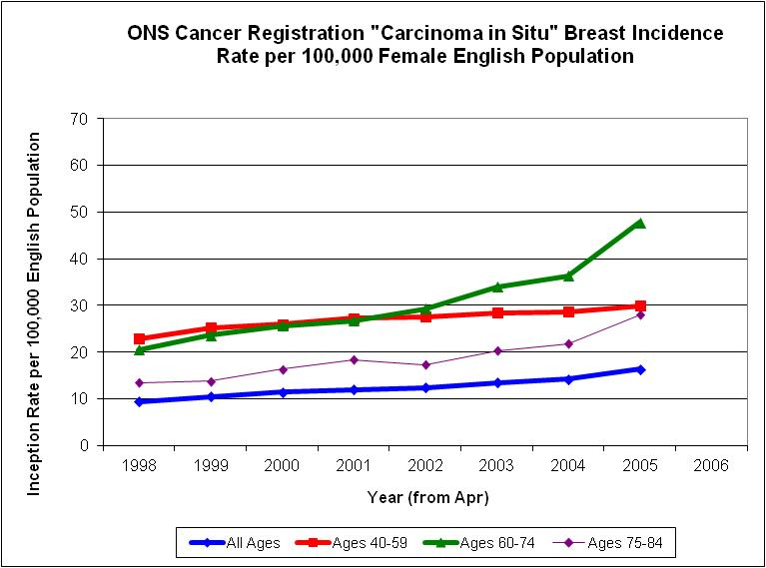
Population Statistics
Base Incidence Rates for DCIS
Non-Invasive Breast Tumour
ICD10 Code “D05”
HES Data;
Cancer Registry Data (ONS);
Rates by Age of Population
Created by dividing by population estimates;
Comparison to US estimates;

Slide 21
Further Adjustments
Allow for treatment by Mastectomy
Total excision of breast total mastectomy ; OCPS Codes 27.1 to 27.4;
Current proportions only
Any Moral Hazard?
Trending to present day
Impact of Underwriting / Select Effect
Relevant risk factors underwritten for?
Overlaps with existing CI conditions
Screening Changes
Insured Population Differences arising from different socio-economic mix

Slide 22
Developing New CI Conditions
Notes:
Good afternoon, thank you etc
Brief intro….
Deciding what impairments to cover and generating ideas for new conditions
Design process itself, with real-life examples
Practical implications for both Underwriting and Claims
So within the next 20 minutes or so, if you’re not already experts in developing new CI conditions, you will be!

Slide 23
How can we decide what impairments to cover?
Customer need
Sufficient statistics to price
Able to underwrite
Able to assess claims

Slide 24
Where do the ideas come from?
Plugging the gaps
Refuted claims
Medical advances
Exclusions
TPD
Customers / advisers
International markets
Competitive differentiation
Overlaps at zero cost
Notes:
Ideas can come from anywhere but these are the main sources

Slide 25
Types of new CI conditions
ABI +
Full payment conditions
Partial payment conditions
Additional vs accelerated
Notes:
Unless you’re making a structural change to your CI product design, new conditions fall into three major categories…
ABI +
Full
Partial

Slide 26
Development process
Team effort between all the disciplines
Key design principles
How much cover

Slide 27
Devising wordings
Actuarial
Legal
Underwriting
Claims
Medical
Marketing
Customer
Notes:
Obviously the customer is always at the heart of our aims…
It could start anywhere and in practice it’s much more complicated than implied by the arrows. The process is largely iterative and can go through several variations e.g. if price too high make the definition stricter….
The process is further complicated as more than one reinsurer is often involved.

Slide 28
Key design principles
Clear and objective definitions
what is covered?
what are the claim triggers?
what is not covered?
Match to company philosophy and pricing
As close as possible to medical definitions
Future-proofed against medical advances
Notes:
Recap on key design points

Slide 29
How much cover?
Diagnosis:
expensive, customer friendly
Symptoms and / or Treatment:
future-proof against changes
Advanced Impairment:
cheaper, more declined claims
Notes:
Designing a CI definition all boils down when you payout. This will drive the price to This slide is about how much cover to give under each CI definition

Slide 30
ABI Statement of Best Practice
Clarity
Generic terms
Model wordings
Model exclusions
Prescribed guidelines on use of headings, sub-headings, limitations of cover
Notes:
Recap on key design points

Slide 31
Example 1 – Breast ductal carcinoma in situ
Mastectomy for ductal carcinoma in situ
We will pay the lower of £25,000 and 25% of the sum insured if the life insured is treated by total mastectomy for a histologically confirmed ductal carcinoma in situ.
Notes:
Covering every mastectomy for 100% payment could hike basic female premium rates by about 4%. This would be unacceptable. Therefore, restricted:
Partial payment only
DCIS only
Every word makes a difference.
It goes without saying need to keep the wordings short and user-friendly.
Customize accordingly e.g. life insured vs policyholder vs member etc
What isn’t covered:
DCIS treated by lumpectomy and/or radiotherapy
LCIS

Slide 32
Example 1 – Breast ductal carcinoma in situ
Mastectomy for ductal carcinoma in situ
We will pay the lower of £25,000 and 25% of the sum insured if the life insured is treated by total mastectomy for a histologically confirmed ductal carcinoma in situ.
Alternative definitions
Lumpectomy
Lobular carcinoma in situ
Notes:
What isn’t covered:
DCIS treated by lumpectomy and/or radiotherapy
LCIS
Some definitions allow for payment even if there is no lumpectomy
Other definitions pay out for mastectomy even if it was performed for LCIS
While a third definition pays out for lumpectomy for LCIS – this is obviously the most expensive option.
It’s a controversial area as it depends on your views about what the customer wants and what they are prepared to pay. My view is LCIS treated by lumpectomy is not a critical illness.
What will we cover next a pimple on the bottom?

Slide 33
Example 2 – Carcinoma in situ of the urinary bladder
Carcinoma in situ of the urinary bladder
We will pay the lower of £12,500 and 12.5% of the sum insured if the life insured is diagnosed with carcinoma in situ of the urinary bladder.
The diagnosis must be histologically confirmed on a pathology report. This benefit is payable only once. Non-invasive papillary carcinoma, stage Ta bladder carcinoma and all other forms of non-invasive carcinoma are specifically excluded.
Notes:
No treatment restriction
But note restricted to only one payment
Also specifically exclude stage Ta to avoid any doubt

Slide 34
Underwriting and Claims Implications
Notes:
So you’ve completed your product design – what next?

Slide 35
Underwriting & Claims
Terms and Conditions;
Marketing literature;
Application form;

Slide 36
Underwriting Implications
Underwriting guidelines
Evidence requirements
Ratings
Exclusions (premium discount?)
Information and training

Slide 37
Claims Implications
Implementation date
Claims guidelines
Evidence requirements
Philosophy guidelines
Information and training
Notes:
Many thanks to Mr Grant in the audience who helped me to devise this slide and has agreed to field any of your difficult claims related questions.
The effective date of implementation is key. Not always black and white as some new conditions are introduced retrospectively. Another example is using quote date rather and policy in-force date.
Evidence requirements and philosophy guidelines may need to be updated with amendments to claim forms, target GP reports etc.
Communication of the details to the rest of the claims team is vital. Hopefully the definition wording will be crystal clear as to when a claim is valid, whether it’s partial or full, additional or accelerated etc. etc. Nevertheless, it’s worthwhile going through the new definitions to make sure everybody interpretes the wording in the same way.

Slide 38
Summary
Deciding what impairments to cover and generating ideas for new conditions
Key principles for designing definitions
Practical implications for both Underwriting and Claims

Slide 39
Thank you for your attention.
Peter Banthorpe, pbanthorpe@rgare.com
Yunus Piperdy, ypiperdy@rgare.com

